Slide 1
ACTIVITY RECOGNITION IN SMART HOME ENVIRONMENTS
CS 284 Mini Project Presentation by Inna Calimbahin and Isabelle Tingzon

Slide 2

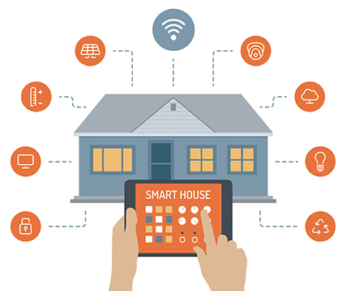
ACTIVITY RECOGNITION FOR HEALTH MONITORING
Activities of daily living (ADLs) are good indicators of elderly health status.
Smart home environments are capable of monitoring activities performed by its inhabitants.
Activity Recognition is a key component in automated health monitoring.

Slide 3
In our study, we use CRFs and HMMs for activity recognition in smart home environments.
Their performances are then compared with other classifiers i.e. SVM, Decision Trees, and Gaussian Naive Bayes classifier.

Slide 4

PRELIMINARIES: SENSOR DATA
Sensor data is composed of temporal data generated by a set of binary sensors installed in a home environment.
Fig 1. Home Settings Description

Slide 5
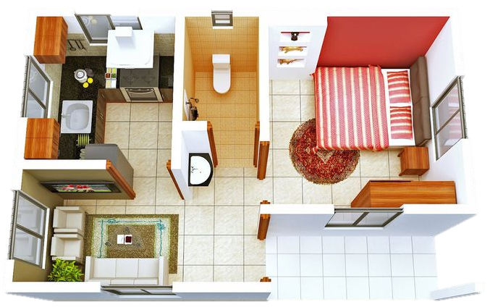
TYPES OF SENSORS: OrdonezA
Pressure: (1) Bed, (2) Seat
PIR: (3) Shower, (4) Basin, (5) Cooktop
Magnetic: (6) Main door, (7) Fridge, (8) Cabinet, (9) Cupboard
Flush: (10) Toilet
Electric: (11) Microwave, (12) Toaster
10
5
3
1
9
8
7
4
2
6

Slide 6
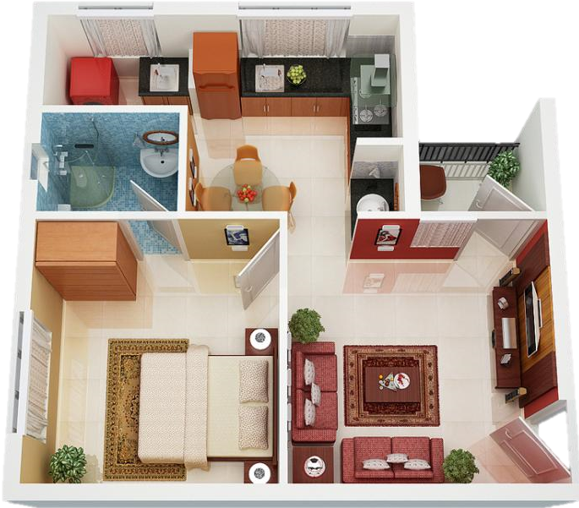
TYPES OF SENSORS: OrdonezB
Pressure: (2) Seat, (1) Bed
PIR: (3) Shower, (4) Basin, (5) Door Kitchen, (6) Door Living, (7) Door Bedroom
Magnetic: (8) Main door, (9) Fridge, (10) Cupboard
Flush: (11) Toilet
Electric: (12) Microwave
9
4
10
3
5
8
7
6
2
1

Slide 7
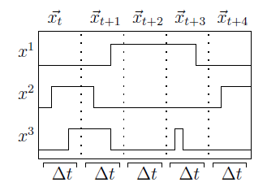
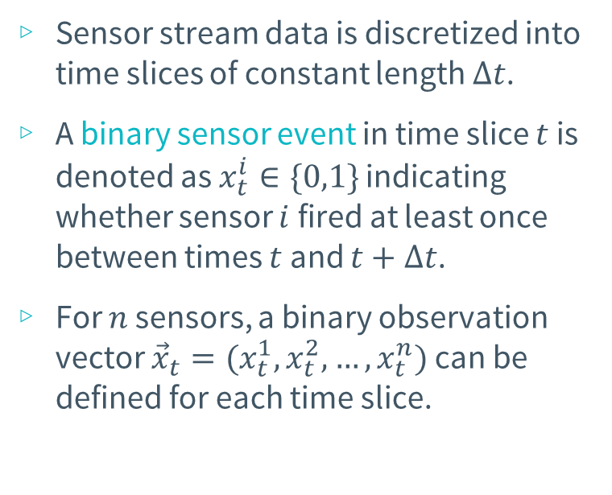
SENSOR STREAM DISCRETIZATION
Sensor stream data is discretized into time slices of constant length $Δt$.
A binary sensor event in time slice $t$ is denoted as $x_{t}^{i}∈\{0,1\}$ indicating whether sensor $i$ fired at least once between times $t$ and $t+Δt$.
For $n$ sensors, a binary observation vector ${\vec{x}}_{t}=(x_{t}^{1}, x_{t}^{2}, …, x_{t}^{n})$ can be defined for each time slice.
Fig 2. Temporal segmentation

Slide 8
SENSOR DATA: DAY AND TIME
Apart from the actual sensor events, the time of day and day of the week that the events occur are also considered valuable features.
Time of Day - values are binned into the following hour ranges:
0-5 (early morning), 5-10 (morning), 10-15 (afternoon), 15-20 (evening), 20-24 (late evening)
Day of the week – can be represented by a unique identifier

Slide 9
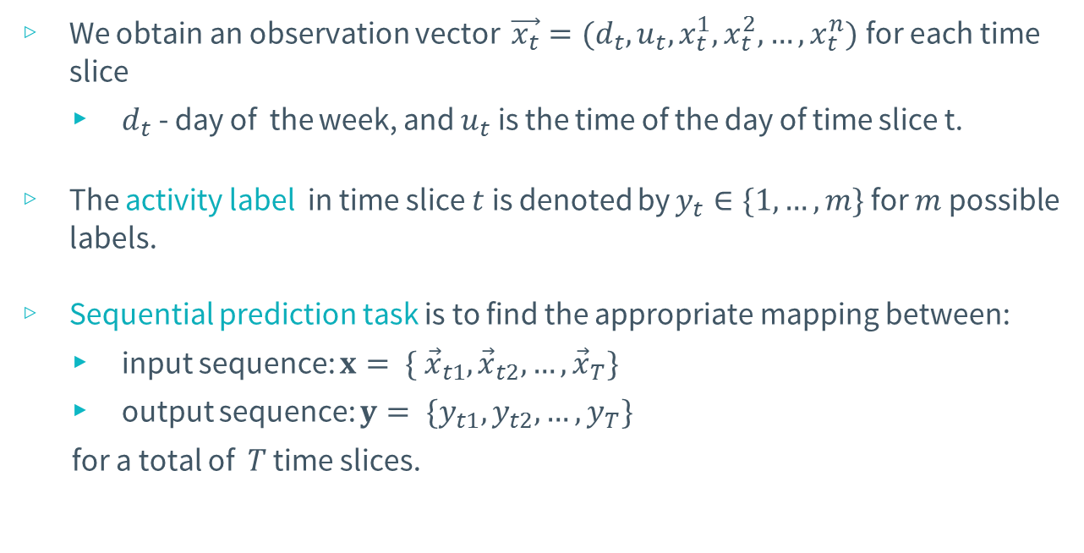
SEQUENTIAL PREDICTION TASK
We obtain an observation vector $\vec{x_{t}}=(d_{t}, u_{t}, x_{t}^{1}, x_{t}^{2}, …, x_{t}^{n})$ for each time slice
$d_{t}$ - day of the week, and $u_{t}$ is the time of the day of time slice t.
The activity label in time slice $t$ is denoted by $y_{t}∈\{1, …, m\}$ for $m$ possible labels.
Sequential prediction task is to find the appropriate mapping between:
input sequence: $x= \{ {\vec{x}}_{t1},{\vec{x}}_{t2}, …,{\vec{x}}_{T}\}$
output sequence: $y= \{y_{t1}, y_{t2}, …, y_{T}\}$
for a total of $T$ time slices.

Slide 10
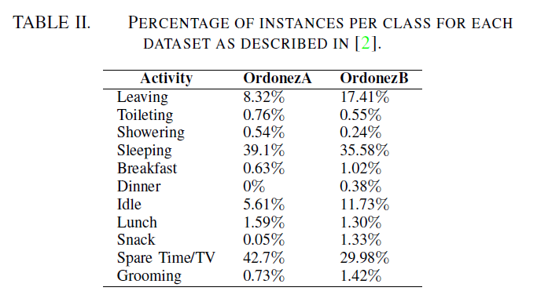
ACTIVITY LABELS
← Unlabelled data

Slide 11
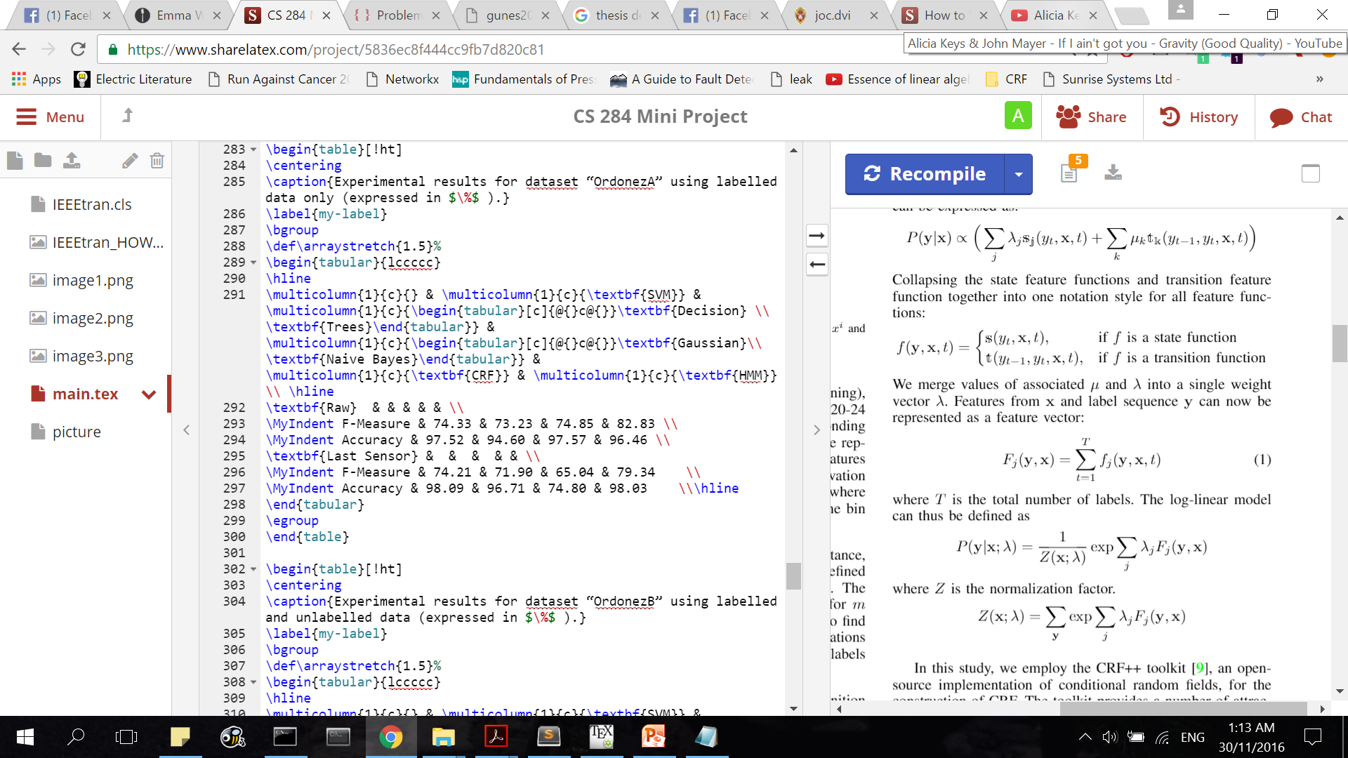
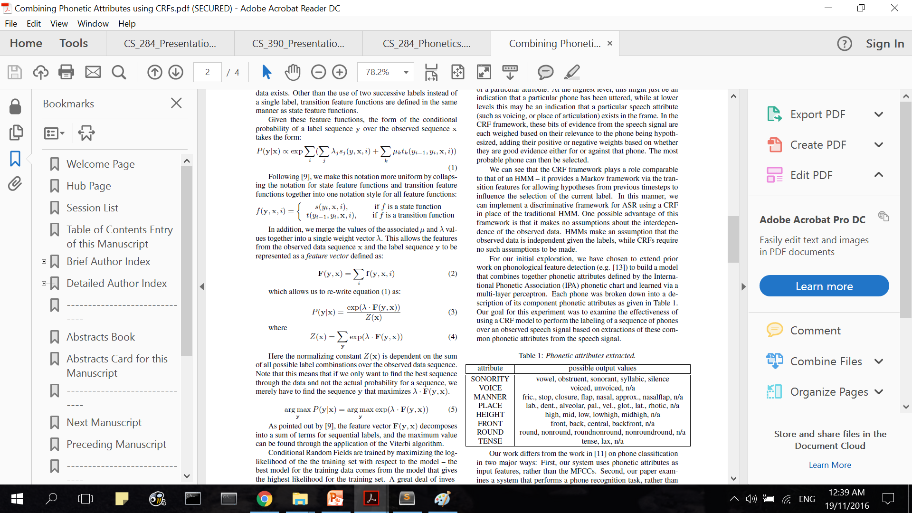
CONDITIONAL RANDOM FIELDS

Slide 12
HIDDEN MARKOV MODELS

Slide 13
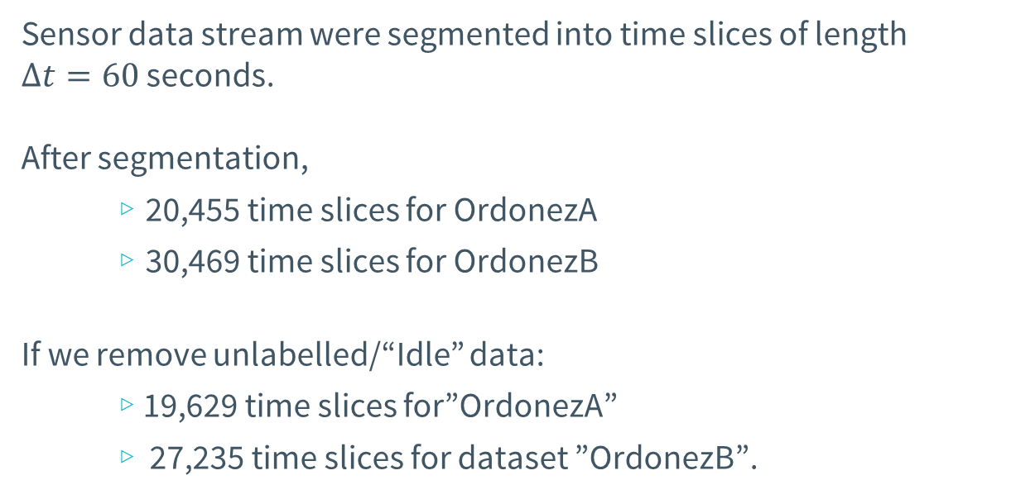
EXPERIMENTAL SETUP
Sensor data stream were segmented into time slices of length $Δt=60$ seconds.
After segmentation,
20,455 time slices for OrdonezA
30,469 time slices for OrdonezB
If we remove unlabelled/“Idle” data:
19,629 time slices for”OrdonezA”
27,235 time slices for dataset ”OrdonezB”.

Slide 14
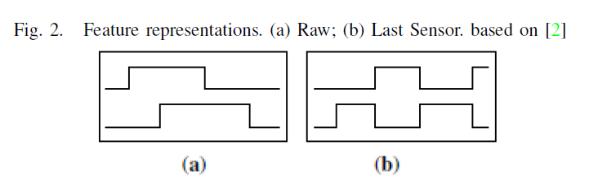
FEATURE REPRESENTATION
Raw sensor representation -produces sensor data as it was received from the WSN, i.e. value is 1 if sensor is active, else 0.
Last sensor representation – indicates which sensor fired last.
The sensor that changed its state last continues to produce a 1 and only changes to 0 when another sensor changes its state to 1.

Slide 15
RAW SENSOR REPRESENTATION
Main Door Sensor
Date | Time | Sensor |  |  |  |  | Activity Label
 |  | 1 | 2 | 3 | 4 | 5
2011-11-29 | 19:01:59 | 0 | 0 | 1 | 0 | 0 | Leaving
2011-11-29 | 19:02:59 | 0 | 0 | 0 | 0 | 0 | Leaving
… | … | … | … | … | … | … | …
2011-11-29 | 20:21:59 | 0 | 0 | 0 | 0 | 0 | Leaving
2011-11-29 | 20:22:59 | 0 | 0 | 1 | 0 | 0 | Leaving
2011-11-29 | 20:22:59 | 0 | 0 | 0 | 1 | 0 | Spare Time/TV

Slide 16
LAST SENSOR REPRESENTATION
Main Door Sensor
Date | Time | Sensor |  |  |  |  | Activity Label
 |  | 1 | 2 | 3 | 4 | 5
2011-11-29 | 19:01:59 | 0 | 0 | 1 | 0 | 0 | Leaving
2011-11-29 | 19:02:59 | 0 | 0 | 1 | 0 | 0 | Leaving
… | … | … | … | … | … | … | …
2011-11-29 | 20:21:59 | 0 | 0 | 1 | 0 | 0 | Leaving
2011-11-29 | 20:22:59 | 0 | 0 | 1 | 0 | 0 | Leaving
2011-11-29 | 20:22:59 | 0 | 0 | 0 | 1 | 0 | Spare Time/TV

Slide 17
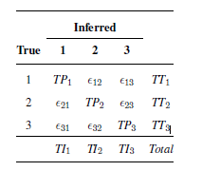
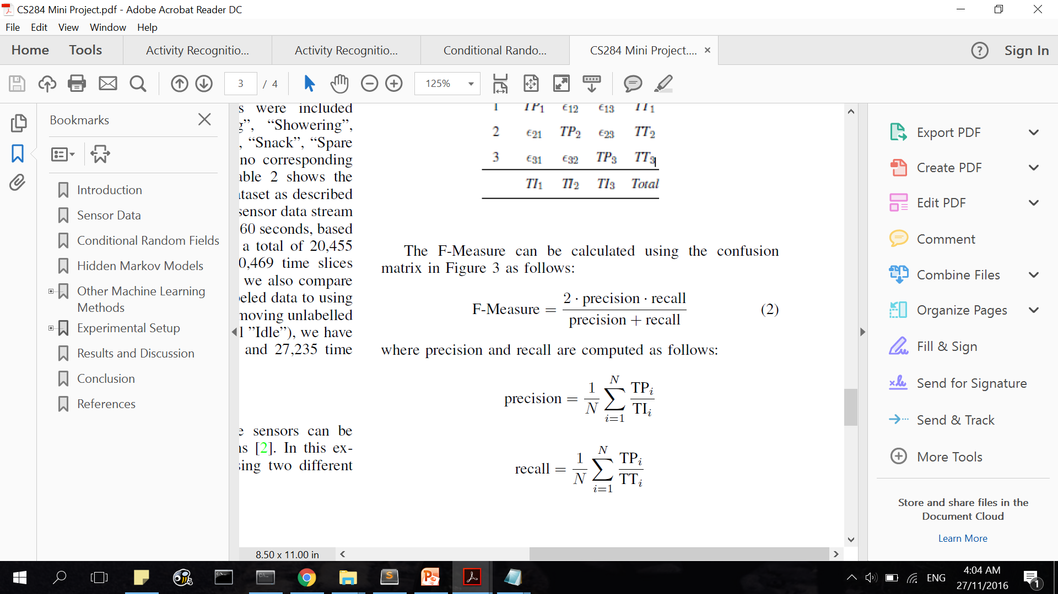
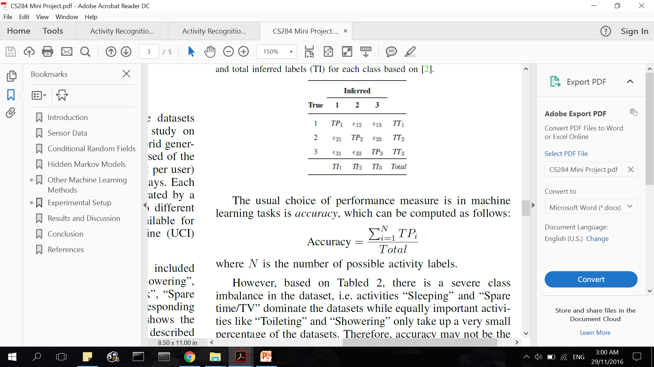
PERFORMANCE MEASURE: F-MEASURE
nature of the dataset → severe class imbalance
Accuracy may not be a suitable performance measure.
F-Measure considers correct classification of each class as equally important.

Slide 18
VALIDATION
Leave-one-day-out approach
takes one full day of sensor readings as the test set and uses the remaining sensor readings as the training set.
process is repeated for all the days and reports the average F-Measure over the total number of days
OrdonezA – 14 days
OrdonezB – 21 days

Slide 19
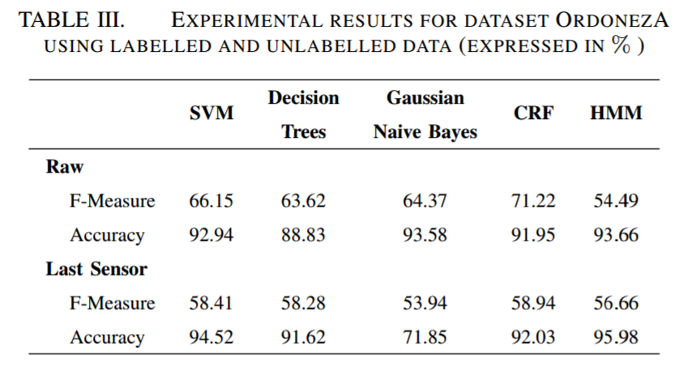
RESULTS (ORDONEZA)

Slide 20
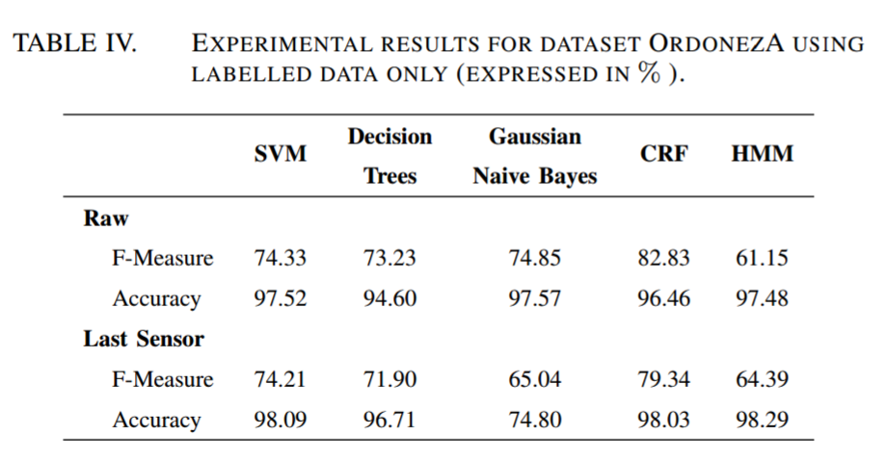
RESULTS (ORDONEZA)

Slide 21
RESULTS (ORDONEZB)

Slide 22
CONCLUSION
Overall, CRFs outperform the other machine learning methods for both datasets “OrdonezA” and “OrdonezB”
the highest F-Measure being 82.83%
Higher performance measures are achieved for datasets with only labelled data than datasets with unlabelled data.
We conclude that CRFs and HMMs are effective in classifying activities of daily living based on binary sensor stream data.

